Slide 1
Software Verification Validation and Testing
Prepared by : Neha Tripathi

Slide 2
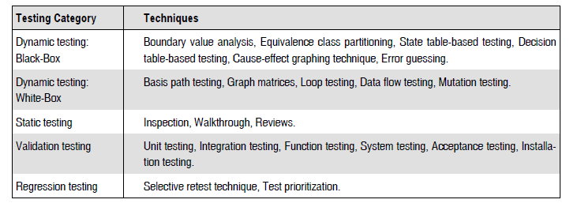
Testing techniques

Slide 3
STATE TABLE-BASED TESTING
FINITE STATE MACHINE (FSM)
An FSM is a behavioral model whose outcome depends upon both previous and current inputs.
FSM models can be prepared for software structure or software behavior. And it can be used as a tool for functional testing.
STATE TRANSITION DIAGRAMS OR STATE GRAPH
A system or its components may have a number of states depending on its input and time. For example, a task in an operating system can have the following states:
1. New State: When a task is newly created.
2. Ready: When the task is waiting in the ready queue for its turn.
3. Running: When instructions of the task are being executed by CPU.
4. Waiting: When the task is waiting for an I/O event or reception of a signal.
5. Terminated: The task has finished execution.

Slide 4
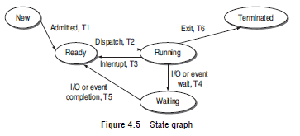
The state graph of task states is shown in Fig.
Each arrow link provides two types of information:
Transition events like admitted, dispatch, interrupt, etc.
2. The resulting output from a state like T1, T2, T3, etc.
T0 = Task is in new state and waiting for admission to ready queue
T1 = A new task admitted to ready queue
T2 = A ready task has started running
T3 = Running task has been interrupted
T4 = Running task is waiting for I/O or event
T5 = Wait period of waiting task is over
T6 = Task has completed execution

Slide 5
STATE TABLE
State graphs of larger systems may not be easy to understand. Therefore, state graphs are converted into tabular form for convenience sake, which are known as state tables.
State tables also specify states, inputs, transitions, and outputs.
The following conventions are used for state table :
Each row of the table corresponds to a state.
Each column corresponds to an input condition.
The box at the intersection of a row and a column specifies the next state (transition) and the output, if any.

Slide 6
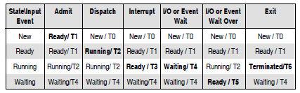
The state table for task states is given in Table below:
The highlighted cells of the table are valid inputs causing a change of state. Other cells are invalid inputs which do not cause any transition in the state of a task.

Slide 7
STATE TABLE-BASED TESTING
After reviewing the basics, we can start functional testing with state tables.
A state graph and its companion state table contain information that is converted into test cases.
The procedure for converting state graphs and state tables into test cases is discussed below.
1. Identify the states
2.Prepare state transition diagram after understanding transitions between states
3. Convert the state graph into the state table as discussed earlier
4. Analyse the state table for its completeness
5. Create the corresponding test cases from the state table

Slide 8
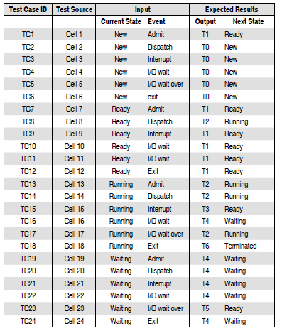
Test cases derived using state table:

Slide 9
Thank you!

